Slide 1

A presentation by :-
Dhruv Kundrai (2210990276)
Dhruv Walia (2210990280)
Dipanshu Saini (2210990288)

Slide 2


Air Quality Index (AQI) prediction is a critical tool for safeguarding public health and the environment. AQI measures the concentration of various pollutants in the air, providing a clear indicator of air quality and potential health risks. Predicting AQI enables proactive measures to mitigate pollution, inform policy decisions, and protect communities.
This presentation explores the fundamentals of AQI, the technologies and methodologies used for its prediction, and the practical applications and future trends in this essential field. By understanding and improving AQI prediction, we can take significant steps towards ensuring cleaner air and a healthier future for all.

Slide 3
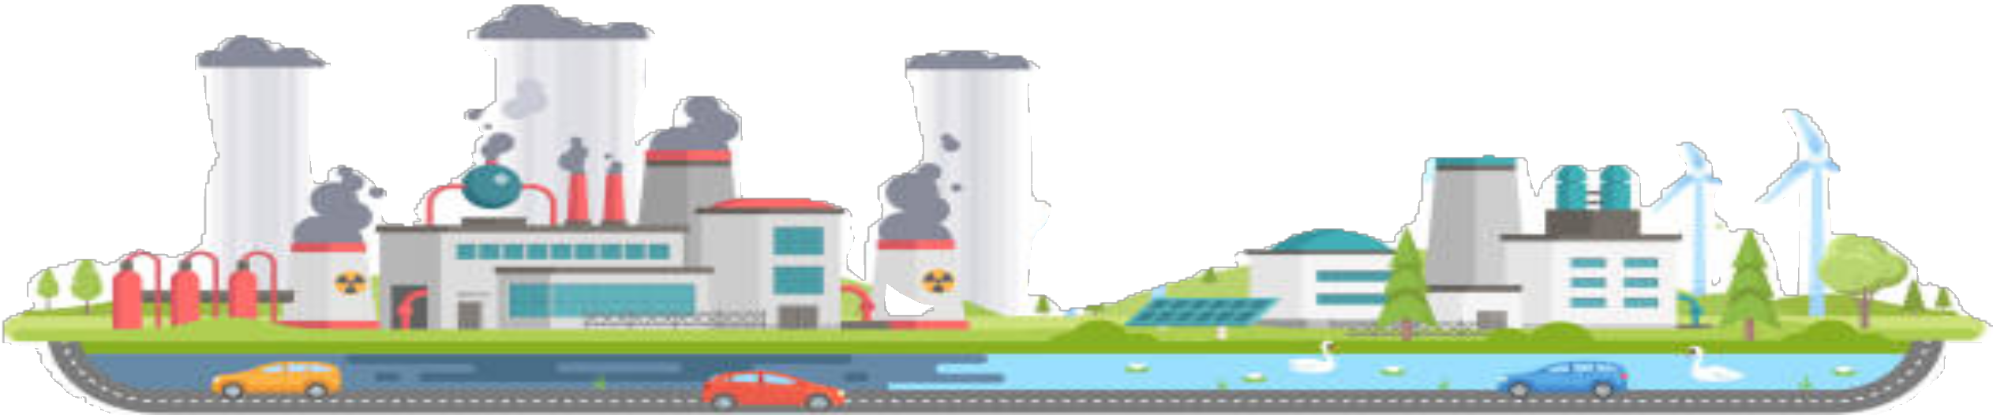
Air pollution is a growing global issue, significantly impacting public health and the environment.The Air Quality Index (AQI) is a standardised indicator used worldwide to communicate the quality of air in a region, quantifying the concentration of various pollutants and their potential health effects. As urbanisation and industrial activities increase, the need for accurate AQI prediction models becomes imperative to inform and protect the public.
Traditionally, AQI forecasting has relied on statistical methods and historical data trends. However, with the advent of Artificial Intelligence and Machine Learning (AIML), more sophisticated and accurate prediction models can be developed.These models can handle large datasets, uncover hidden patterns, and provide more precise forecasts.
Our project leverages AIML techniques to build an AQI prediction model. Utilising data science libraries such as Pandas for data manipulation, NumPy for numerical computations, and Seaborn and Matplotlib for data visualization, we aimed to create a comprehensive and reliable model. Initial attempts with linear regression were inadequate, leading us to adopt logistic regression, which better suited our classification needs.

Slide 4
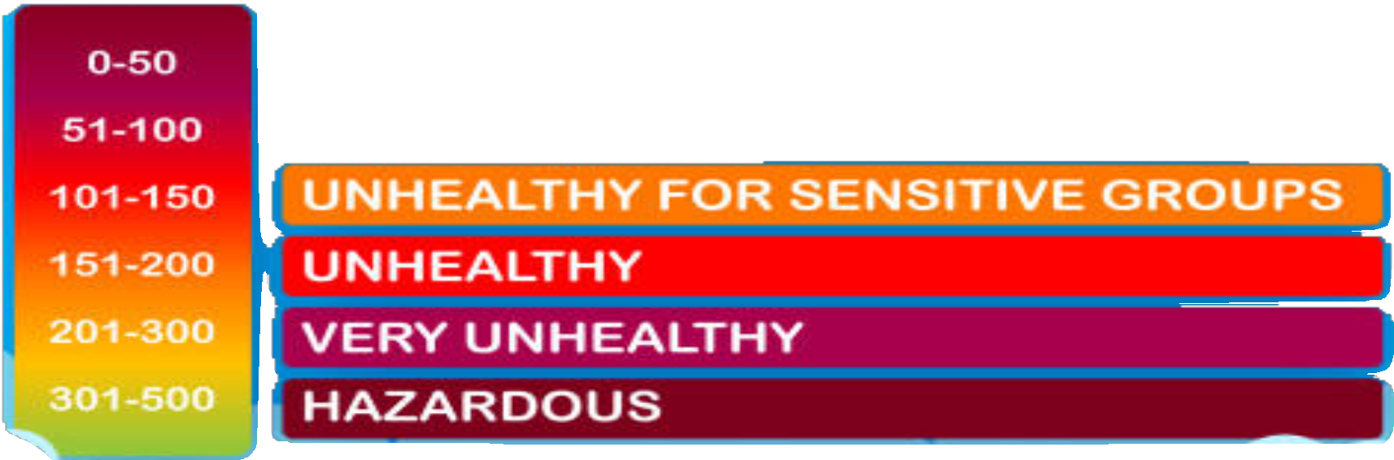
Complexity of Air Pollution Dynamics:
Multiple pollutants with varying sources and behaviours
Influence of meteorological factors
Data Limitations:
Incomplete or low-quality historical air quality data
Limited real-time monitoring infrastructure in some regions
Impact on Public Health and Policy:
Delayed or inaccurate predictions can lead to inadequate responses
Difficulty in implementing timely measures to protect vulnerable populations
Objective:
Develop robust AQI prediction models to provide accurate, real-time air quality forecasts, enabling proactive measures to improve air quality and public health outcomes.

Slide 5

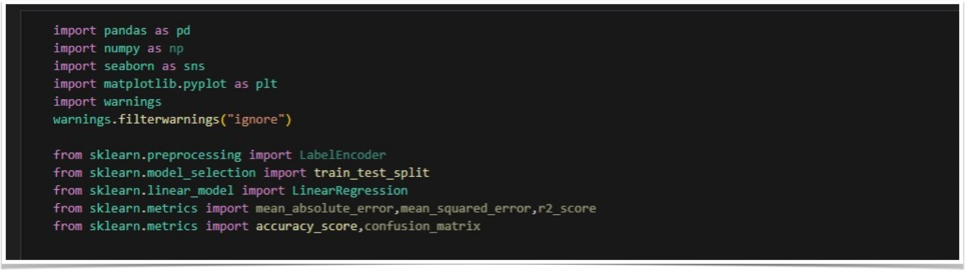
The first & the most crucial step is importing the libraries so as to use the algorithms
for data collection, pre processing and visualisations.

Slide 6

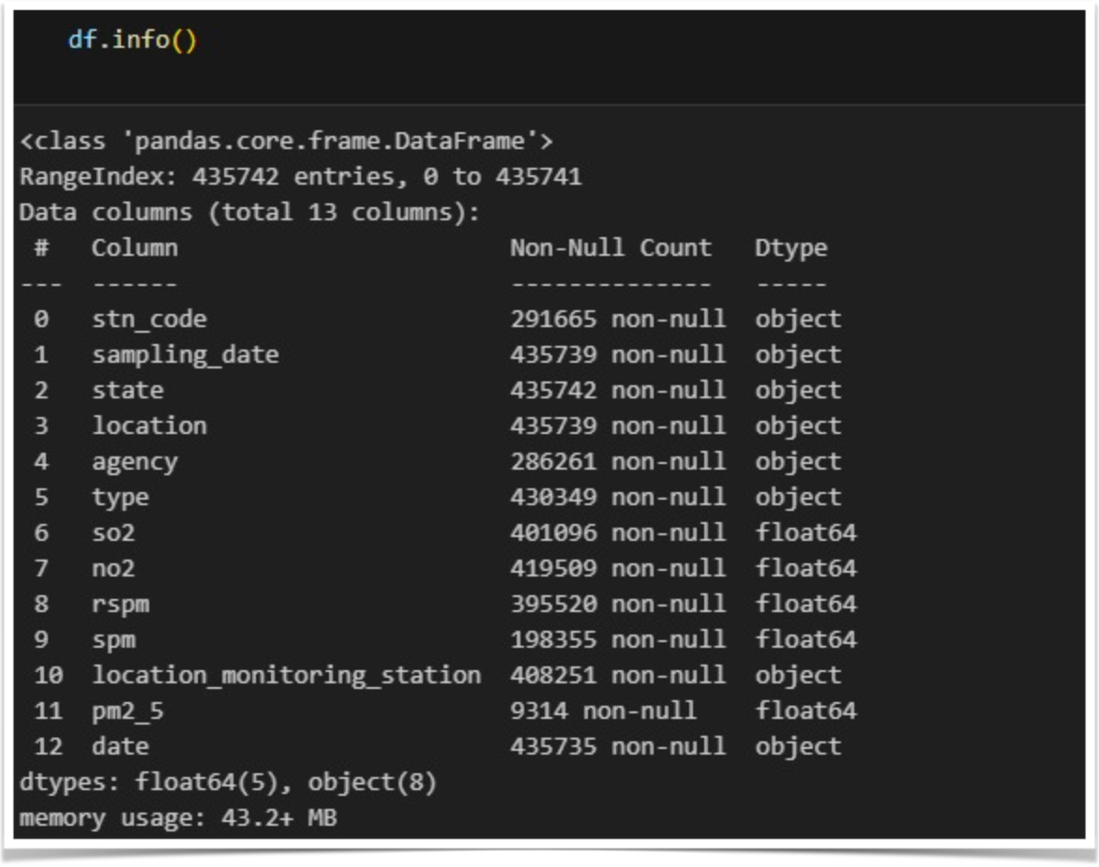
Using .info we found out about the data types such as float, object etc
and found out about the null values for clear indication of data

Slide 7

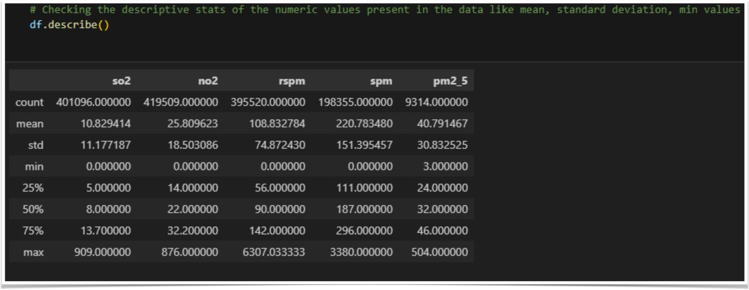
Using the describe function we find the statistical summary of data frames

Slide 8

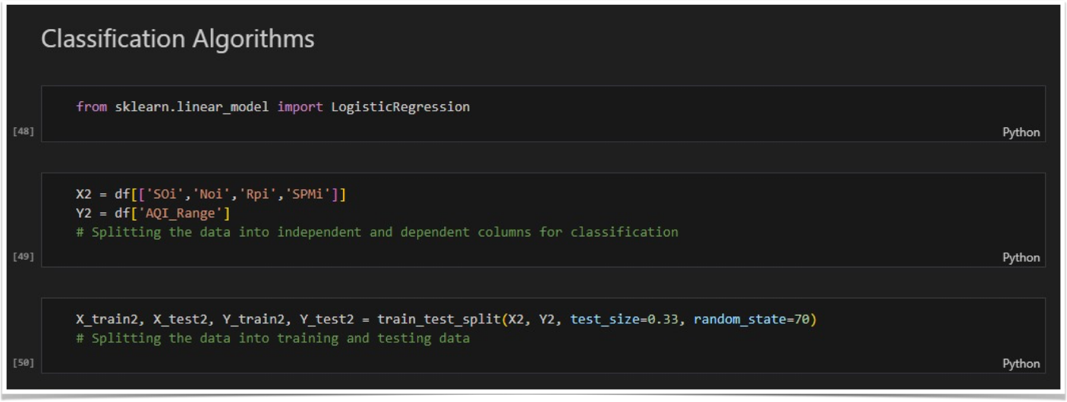
Furthermore, we’ve split the data into training set and testing set for indicating performance
And preventing overfitting.

Slide 9

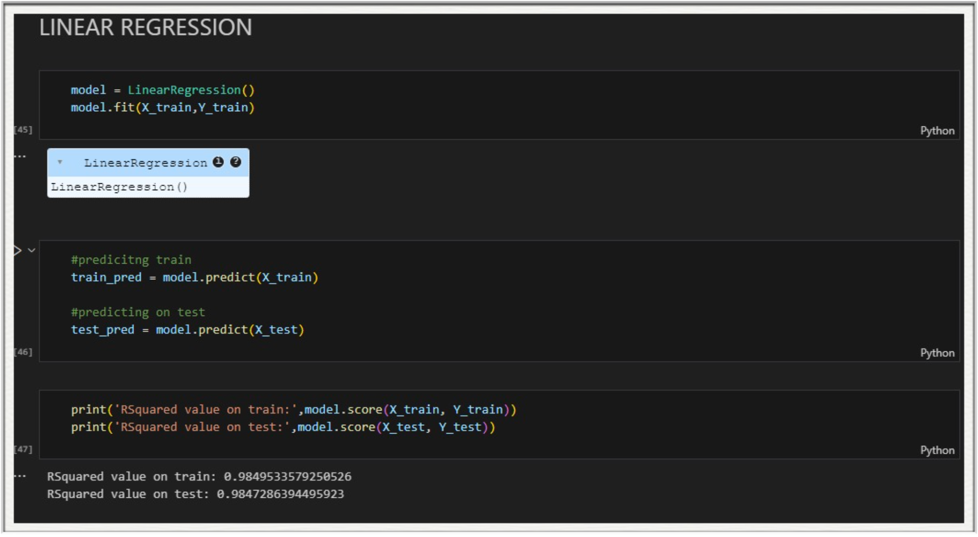
Here we’ve used the linear regression algorithm for fitting the data into the model after which we
Calculated the r squared value which indicated the better fit of the model.

Slide 10

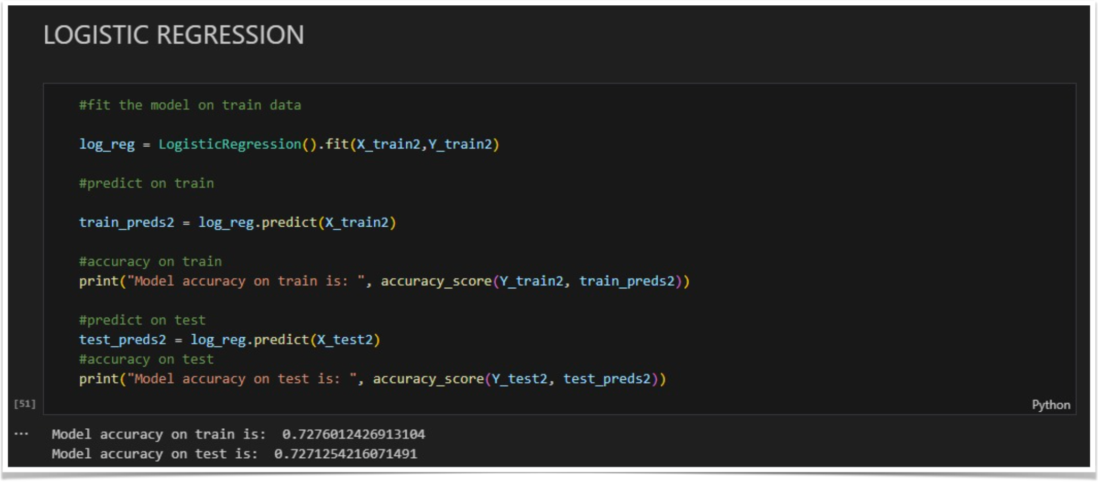
Lastly, we used the logistic regression algorithm for prediction of AQI quality by using the testing set.

Slide 11

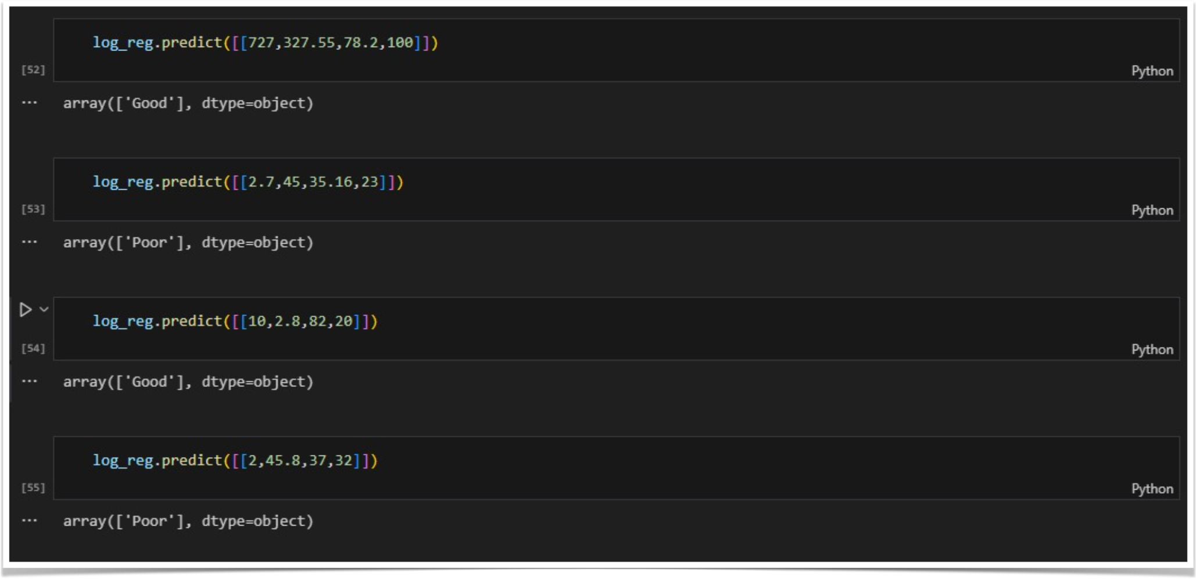
The above image depicts the predicted values of the air quality ranging from ‘Good’ to ‘Poor’

Slide 12

Enhanced Prediction Models:
Integration of advanced machine learning and AI techniques
Use of deep learning for more accurate and dynamic predictions
Improved Data Collection:
Expansion of real-time monitoring networks
Utilisation of satellite and IoT sensors for comprehensive data
Real-Time Analytics and Alerts:
Development of real-time AQI analytics platforms
Implementation of instant public alerts for high pollution levels
Personalised Health Recommendations:
Custom AQI-based health advisories using wearable tech and mobile apps
Personalised action plans for individuals with respiratory conditions
Global AQI Networks:
International cooperation for a global air quality monitoring network
Standardised AQI metrics for global comparison and action

Slide 13





















Summary of Key Points:
Understanding AQI:The importance of monitoring air quality and its impact on health and the environment.
Prediction Challenges: Complexity of pollutants, data limitations, and modelling difficulties.
Technological Advances: Role of machine learning, real-time data collection, and smart city integration.
Importance of AQI Prediction:
Health Protection: Early warnings can prevent health issues caused by poor air quality.
Policy Making: Informed decisions for environmental regulations and urban planning.
Public Awareness: Educating communities about air quality and its implications.
Final Thoughts:
Accurate AQI prediction is essential for a sustainable and healthy future.
Continued innovation and collaboration are key to overcoming current challenges.
Together, we can ensure cleaner air and better quality of life for all.

Slide 14
We thank you for your time and attention throughout this presentation.
We hope you enjoyed this as much as we enjoyed preparing this.

